Slide 1



BVRIT HYDERABAD College of Engineering for Women
Department of Information Technology
Team Tournament
V.Rishitha- 24wh1a6621
S.Surakshitha- 24wh1a6622
J.Bharani- 24wh1a6623
M.Saranya- 24wh1a6624
E.Shivani- 24wh1a6625
Under the Guidance of
Ms.B.Shanmukha Priya
Assistant Professor,
Dept of C.S.E (AI &ML),
BVRIT Hyderabad Collage of Engineering for Women.
June 12, 2025

Slide 2
BVRIT HYDERABAD College of Engineering for Women
Department of Information Technology
Presentation Overview
1
Abstract
2
Introduction
A concise summary of our project.
Setting the stage for our game.
3
Literature Review
4
Technology Stacks
Insights from existing works.
Tools and languages used.
5
Game Images
6
References
Visuals from our development.
Sources and acknowledgments.

Slide 3
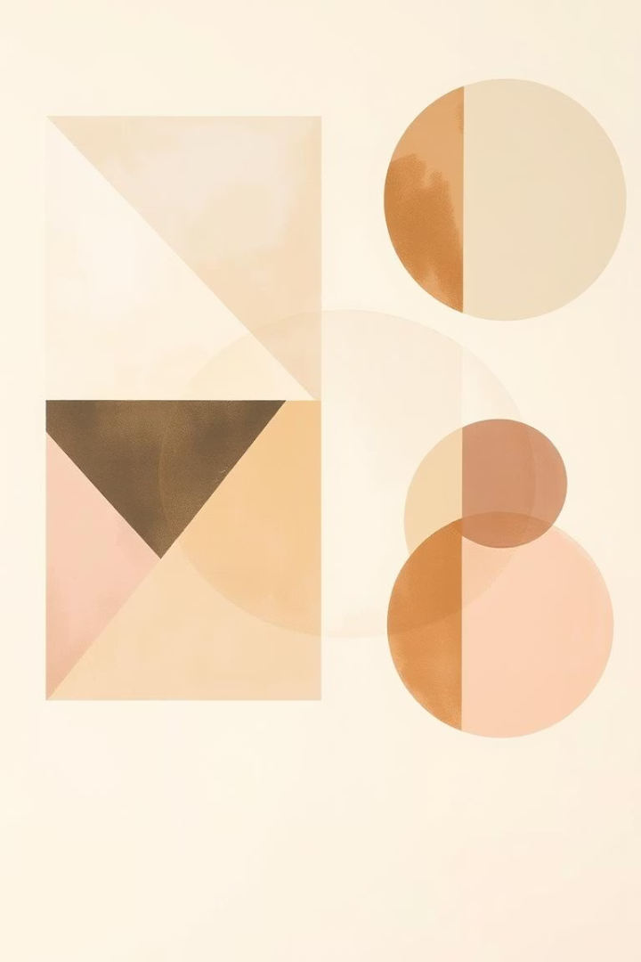
BVRIT HYDERABAD College of Engineering for Women
Department of Information Technology
Abstract: Game Development Summary
The game is developed using Python and the Pygame library, providing a visually appealing interface and responsive controls. This project demonstrates fundamental game development concepts including object-oriented programming, collision detection, angle-based projectile motion, and user interface design. It serves as a learning tool for aspiring game developers and offers players a fun, skill-based gaming experience.
The core objective is to shoot colored bubbles from a launcher at the bottom of the screen to match and eliminate clusters of three or more bubbles of the same color. The game features a triangular grid layout of bubbles that gradually descends, increasing the challenge as the game progresses.

Slide 4




BVRIT HYDERABAD College of Engineering for Women
Department of Information Technology
Introduction to Bubble Shooter
The bubble‑shooter genre originated in Japan in 1994.The Bubble Shooter game is a timeless puzzle genre. Players aim and fire colored bubbles. The goal is to clear the board by matching three or more. Our version enhances this classic with unique features and polished design. It offers hours of entertainment for all ages.
Aim & Shoot
Match & Clear
Timed Challenges
Precision is key to success.
Strategic grouping of bubbles.
Beat the clock for higher scores.

Slide 5
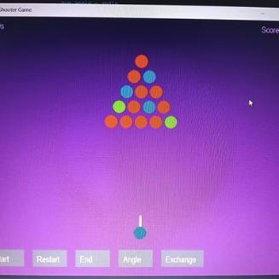
BVRIT HYDERABAD College of Engineering for Women
Department of Information Technology
Key Features
Game Setup: Initializes the game window, color palette, and UI elements like buttons.
Grid Management: Dynamically generates a triangular grid of bubbles with random colors.
Shooting Mechanism: Players can adjust the shooter’s angle to fire bubbles towards the grid.
Collision Detection: Checks if the fired bubble collides with the grid bubbles, removing matched bubbles and updating the score.
Game Mechanics:
Displays score and elapsed time.
Allows players to change bubble colors and angles.
Handles game-over scenarios when bubbles reach the bottom.
User Interface:
Buttons for starting, restarting, and exiting the game.
Interactive angle and bubble exchange selection.

Slide 6
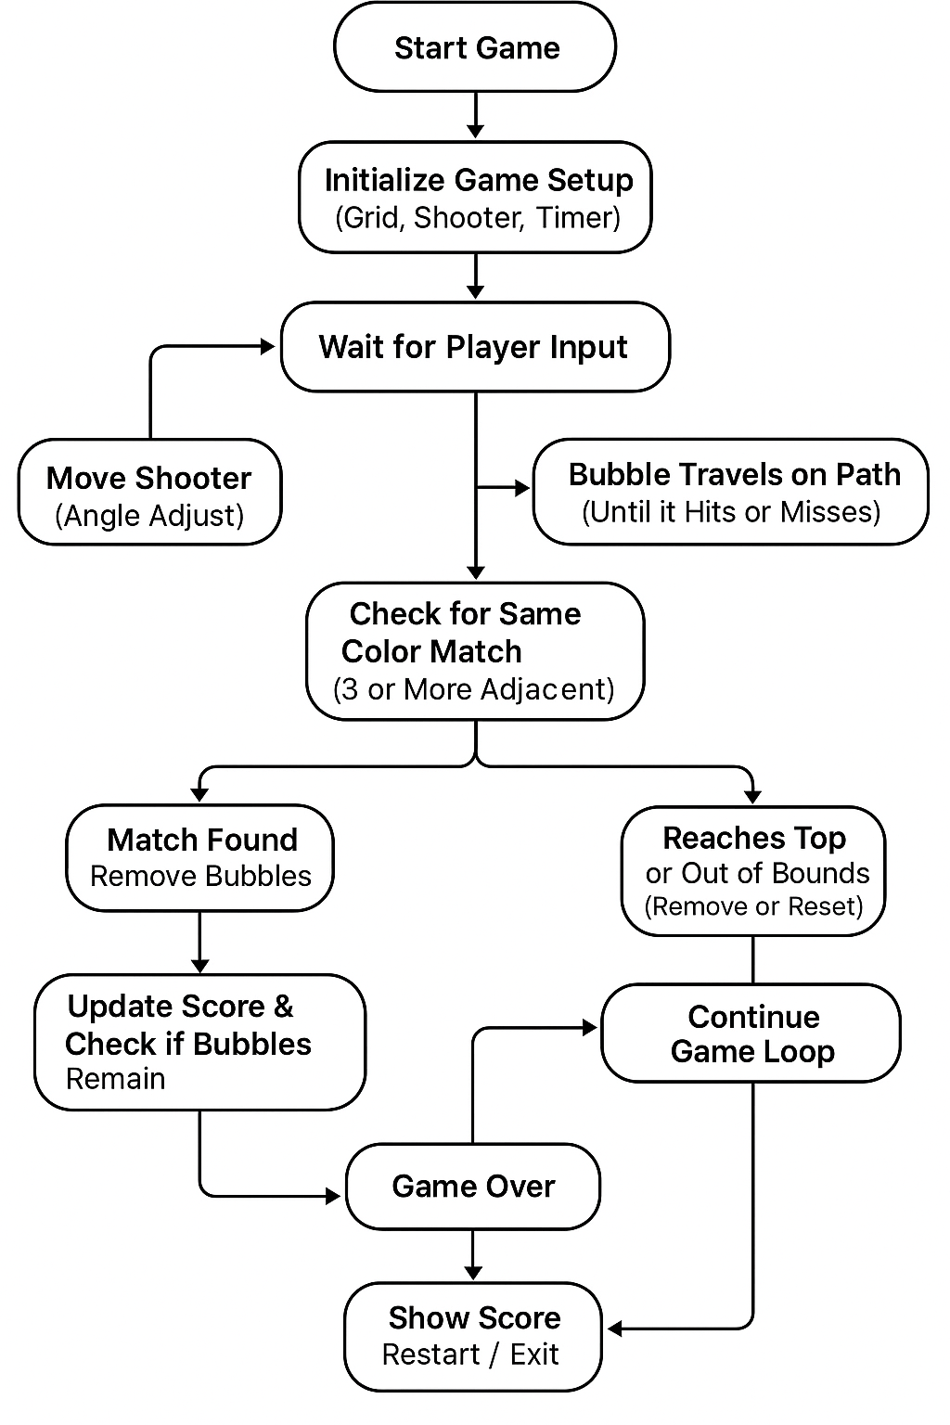
Flow chart

Slide 7
Literature Review: Game Mechanics
Sl.no | title | authors | Publisher | Focused area
1. | "Bubble Shooter Game Used as a Prime for Divergent Thinking" | Jennifer Haase | Creativity Research Journal (Taylor & Francis) | This study investigates the psychological impact of playing Bubble Shooter on creative thinking, especially focusing on divergent thinking and creativity enhancement.
2. | "A Reinforcement Learning Agent for Bubble Shooter Game" | Jian Liu, Xiaoming Liu, Pengfei Wu | International Journal of Computer Games Technology, | The authors developed a reinforcement learning AI agent for Bubble Shooter, focusing on teaching the agent to make optimal shooting decisions through trial-and-error learning.
3. | An Interactive Learning Medium for Young Children | Huei-Tse Hou | IEEE | Color Combination, Arithmetic Operation, Word Formation, and Object Creation

Slide 8

BVRIT HYDERABAD College of Engineering for Women
Department of Information Technology
Technology Stacks: Under the Hood
The libraries used in your Bubble Shooter game code are:
Pygame-For creating the game window, handling graphics, events, drawing shapes, and managing game loop and timing.
Sys- To handle system-level operations, here used to exit the program cleanly.
Math- For mathematical operations like trigonometry (sin, cos, radians, hypot), which are used for calculating angles, movement vectors, and distances.
Random- To generate random choices, such as selecting the bubble colors randomly.
Time- To track elapsed time for the game timer.

Slide 9
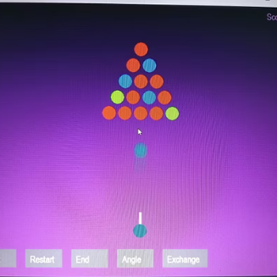
BVRIT HYDERABAD College of Engineering for Women
Department of Information Technology
Output images
Start of the game
Shooting of the bubble

Slide 10
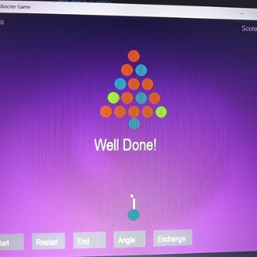
BVRIT HYDERABAD College of Engineering for Women
Department of Information Technology
As we seen above the bubble at the bottom
Started moving towards the triangle grid.
As the colour of the bubble match with the
Colour of the bubble on the grid.
The score will be updated and the users receives
A message called well done

Slide 11
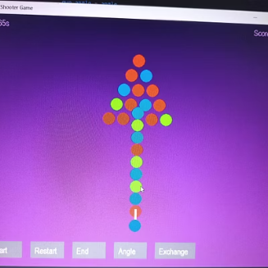
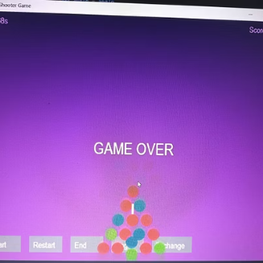
BVRIT HYDERABAD College of Engineering for Women
Department of Information Technology
As the bubble from the bottom does match
the bubble at the grid. Therefore, all the released
Bubble are added to the triangle grid.
All the bubbles reaches the shooter gun
Therefore,games ends with
a message game over.

Slide 12
BVRIT HYDERABAD College of Engineering for Women
Department of Information Technology
References and Acknowledgments
The title “bubble shooter game” "Bubble Shooter Game Used as a Prime for Divergent Thinking
Author: Jennifer Haase, Published in: Creativity Research Journal (Taylor & Francis), 2020
"A Reinforcement Learning Agent for Bubble Shooter Game“, Authors: Jian Liu, Xiaoming Liu
Pengfei Wu, Published in: International Journal of Computer Games Technology, 2019
An Interactive Learning Medium for Young Children,
it was Published in: 2015 International Conference on Cyberworlds (CW)

Slide 13
Thank you

